Slide 1
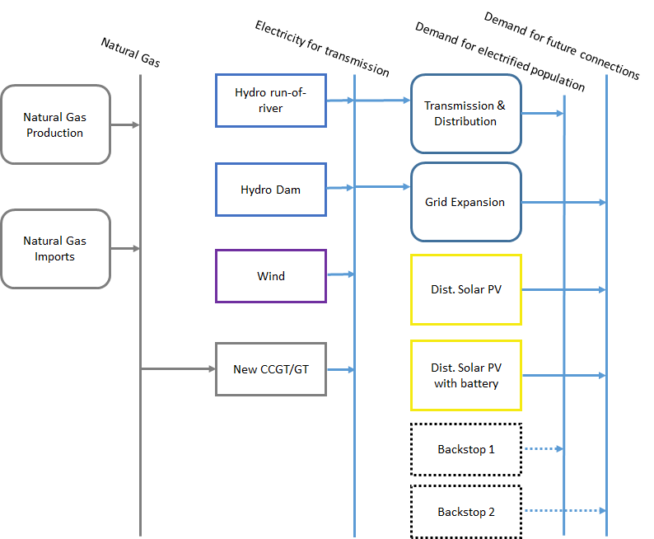
Examples
A training case study:
It contains most key features needed in a model to represent the key dynamics of an energy system, e.g.:
What to invest in when?
How much to invest in?
How to operate it?
What are the costs of these tech’s?

Slide 2
Examples
A training case study:
It contains most key features needed in a model to represent the key dynamics of an energy system.
We will build it together in the next days.

Slide 3
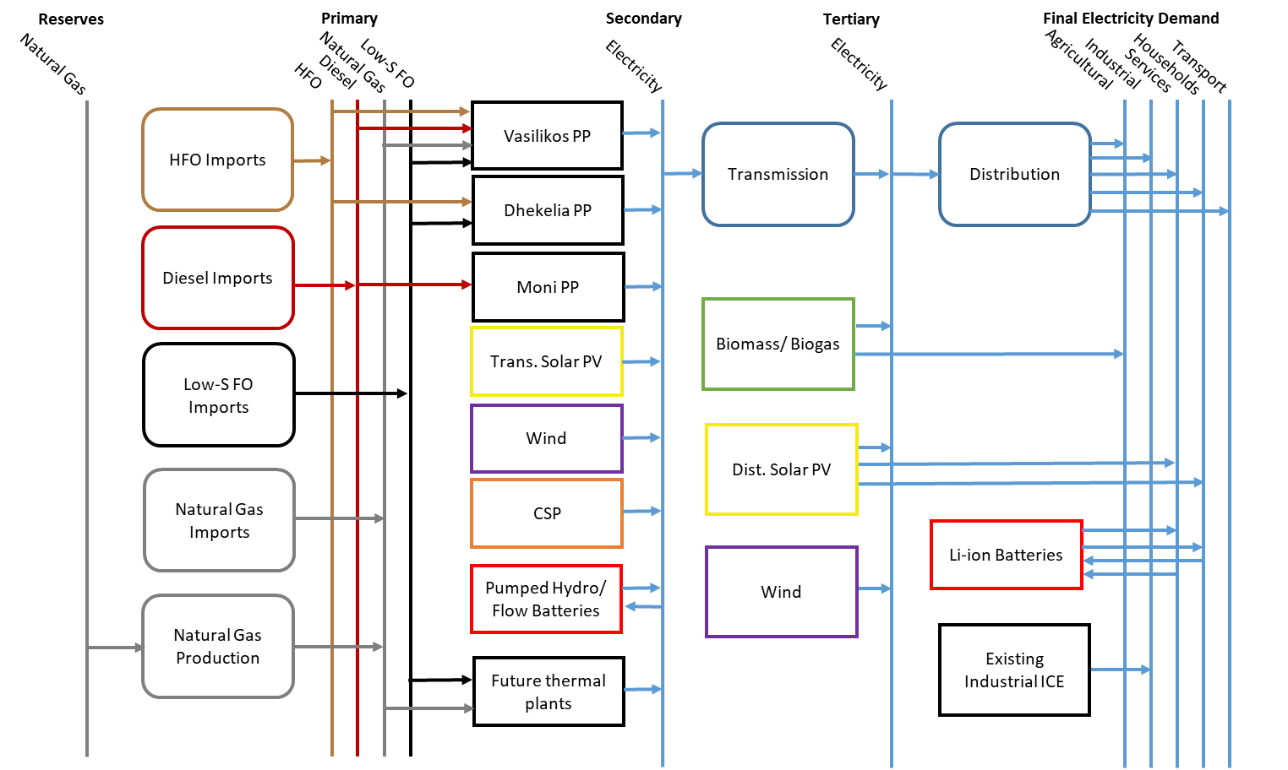
Examples
A model of the electricity system of Cyprus, used by the Government

